Slide 1
Lecture No. 38
At the end of this lecture, students will be able to:
Identify polymers based on physical properties - Homopolymers and copolymers
Explain tacticity in polymers
Nomenclature of a polymer

Slide 2
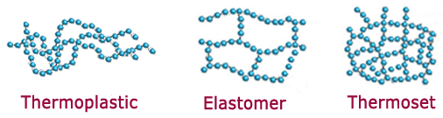
Physical Properties
www.adhesiveandglue.com

Slide 3
Elastomers
Materials which undergo recoverable deformation are called elastomers and exhibit rubber like elasticity
Elastomers → Long chain molecules with some cross-links
Cross-links keeps molecules from slipping past one another permanently
Relative mobility restricted to points between cross-links

Slide 4
Elastomers
Mobile segments
Cross-link points

Slide 5

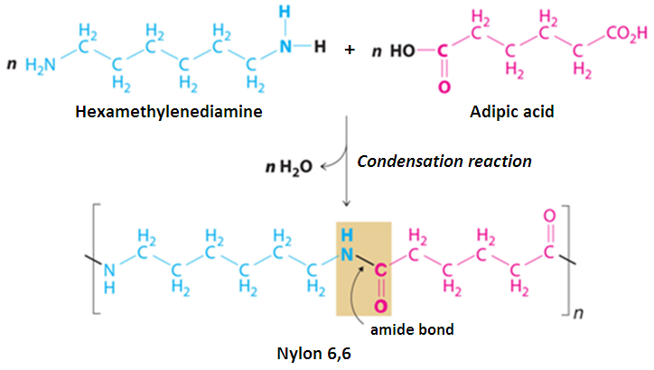
Homo polymers and Hetero polymers
Homopolymers : All the repeating units (“mers”) are the same
-A-A-A-A-A-A-A-A-
Copolymer: polymer made up of 2 or more monomers
Random copolymer: A-B-B-A-A-B-A-B-A-B-B-B-A-A-B
Alternating copolymer: A-B-A-B-A-B-A-B-A-B-A-B-A-B
Block copolymer: A-A-A-A-A-A-A-A-B-B-B-B-B-B-B-B
Homopolymer

Slide 6


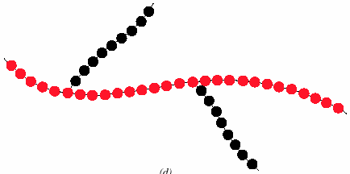

Copolymers
Copolymers : There is more than one type of repeating unit (“mer”) present.
Homopolymer
Block copolymer
Random copolymer
Alternating copolymer
Graft copolymer

Slide 7
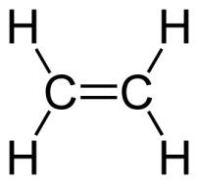
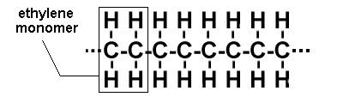
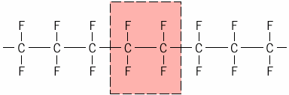
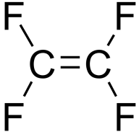
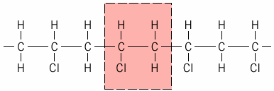
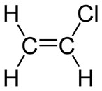
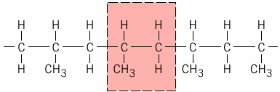
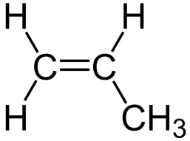
Examples of Homopolymers
polyethylene
(polythene)
polytetrafluoroethylene
PTFE – Teflon
poly(vinyl chloride) PVC
polypropylene PP

Slide 8
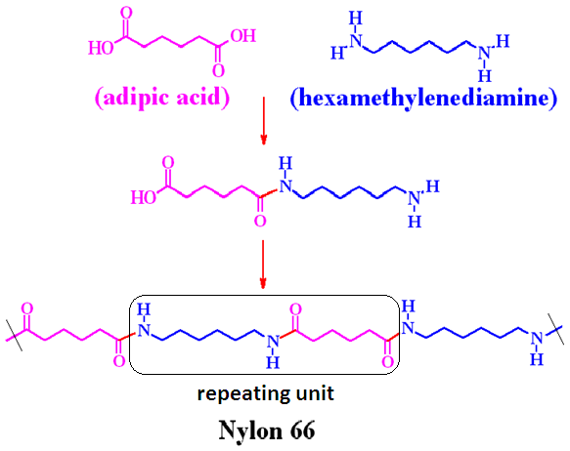
Example of Copolymer

Slide 9
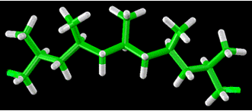
Tacticity in polymers
Isotactic polymer:
All pendant groups are on the same side of the carbon chain

Slide 10
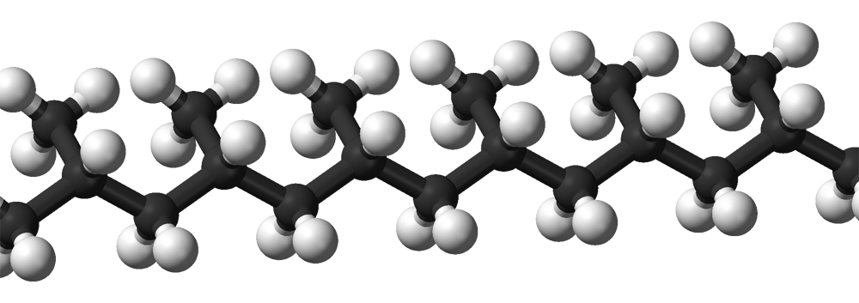
Tacticity in polymers
Isotactic polymer:
All pendant groups are on the same side of the carbon chain

Slide 11
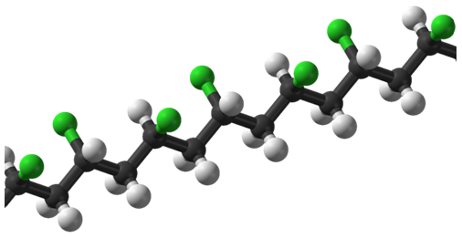
Tacticity in polymers
Syndiotactic polymer:
Pendant groups alternate on either side of the carbon chain

Slide 12
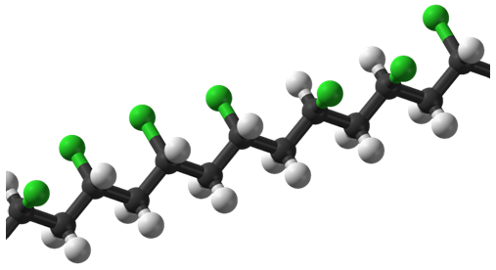
Tacticity in polymers
Atactic polymer:
Pendant groups oriented randomly

Slide 13
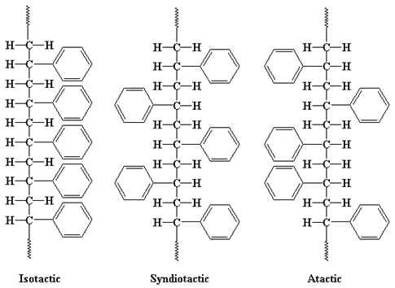
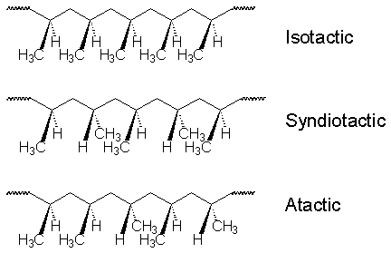
Tacticity in polymers

Slide 14
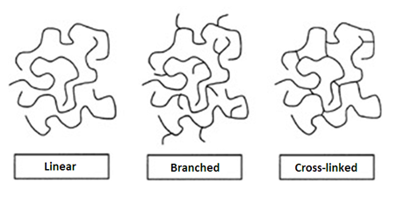
Structure
Handbook of Plastics, Elastomers, and Composites, 4th Edition Charles A. Harper (ed.)

Slide 15
Classification of Polymers
Polymers
Chemistry Physical Prop. Size Shape Structure
Homo- Copolymers Linear Branched Cross-linked Network
polymers
Isomers
Thermo- Thermo- Elastomers
plastic setting
Stereo Positional Geometrical
Isotactic Syndiotactic Atactic cis trans

Slide 16
Naming a Polymer
Subunit-based: To the name of the monomer the prefix poly is added, e.g. styrene → polystyrene; ethylene → polyethylene; propylene → polypropylene – simple homopolymers
Structure-based: IUPAC nomenclature is followed, based on the chemical structure, e.g. Polystyrene is poly(phenylethene); polyethylene is polyethene; polypropylene is poly(propene)
Bond-based: The prefix poly with the added name of the bond, e.g. polysiloxane for −O − Si − linkage. Used as a general umbrella term

Slide 17
Naming a Polymer
Abbreviations: – most likely only capital letters, e.g.: PS for polystyrene; PMMA for polymethylmethacrylate; PTFE for polytetrafluoroethylene – very common and useful in literature, but needs to be defined and is not unique (e.g. PI can be polyisoprene or polyimide)
Trade names: – are used by industry or in daily life, e.g. Plexiglas for PMMA; Styrofoam for PS; Teflon for PTFE – the names have copyright protection and can describe complex polymer mixtures or a specially treated polymer
http://www.e13.physik.tu-muenchen.de/Muellerb/Uebung/chapter01.pdf

Slide 18
Summary
In this class we discussed the following:
Materials which undergo recoverable deformation are called elastomers and exhibit rubber like elasticity
Isotactic polymer: All pendant groups are on the same side of the carbon chain
Syndiotactic polymer:Pendant groups alternate on either side of the carbon chain
Atactic polymer: Pendant groups oriented randomly

